Slide 1



PROJECT
The Hotel Transaction
Data.
Presented by: Nikita Lamsoge

Slide 2

OVERVIEW
01
02
03
Introduction
Question 1
Question 2
04
05
06
Question 3
Question 4
Question 5

Slide 3





INTRODUCTION
QUESTIONS
This presentaion provide a analysis of the hotel transaction data using Tools Like sql & MS-Excel.
We have a Hotel Transaction Database of 3 years which are inter-related to each other, Using SQL queries this data has been cleaned and throughly analysed to draw usefull insights from the data
Is hotel revenue increasing year on year?
What market segment are major contributors of the revenue per year? In there a change year on year?
When is the hotel at maximum occupancy? Is the period consistent across the years?
When are people cancelling the most?
Are families with kids more likely to cancel the hotel booking?

Slide 4

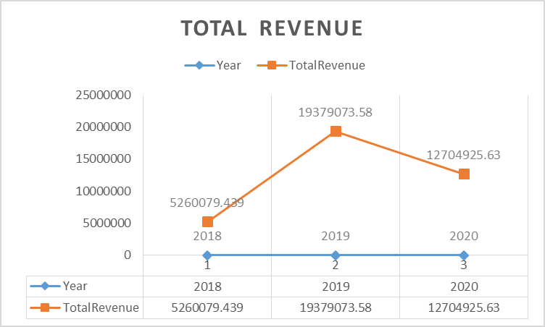
Q-1.Is hotel revenue increasing year on year?
In this Chart We analysis the Total Revenue of 3 years each and it shows Year 2019's Hotel Revenue is highest than other two years and i.e; 19379073.58

Slide 5
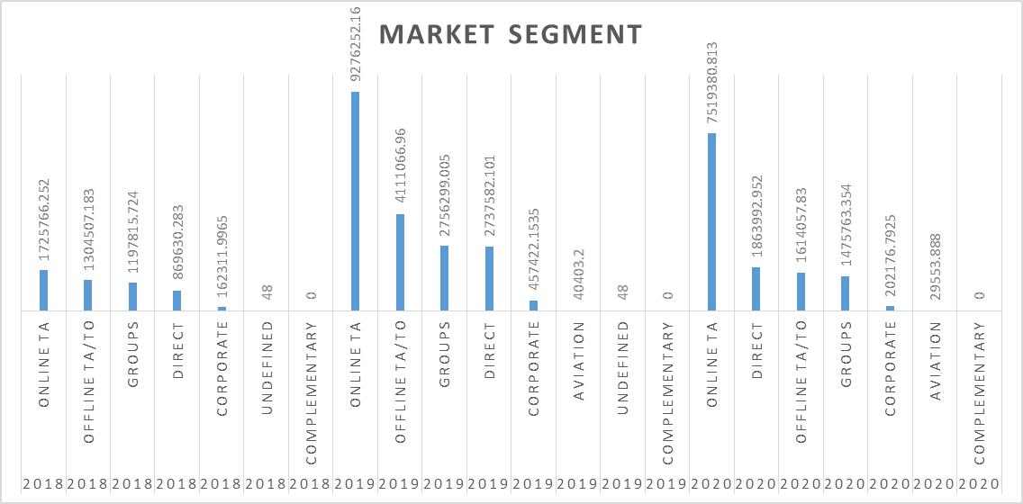
Q-2.What market segment are major contributors of the revenue per year?
Is there a change year on year?
Data shows that online TA is the major contributor to the revenue for all the years

Slide 6
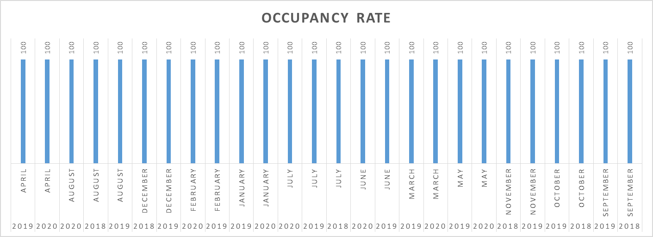
Q-3.When is the hotel at maximum occupancy? Is the period consistent across the years?
July to August period is consistent across all the years

Slide 7
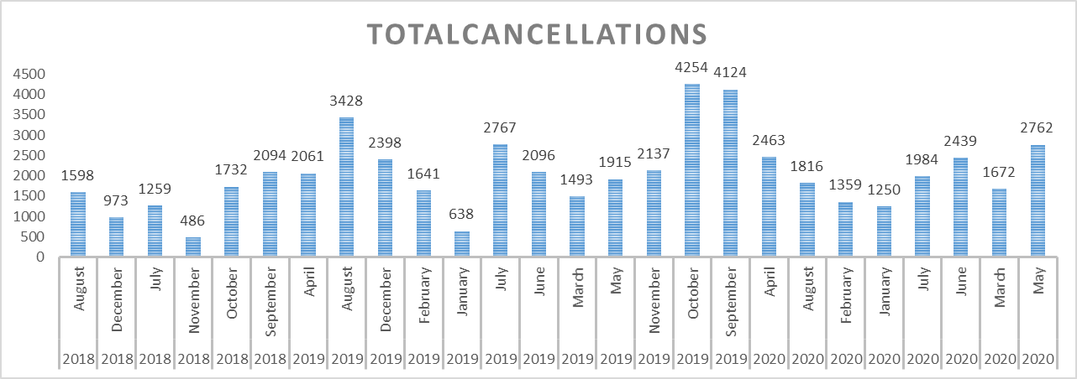
Q-4.When are people cancelling the most?
The data shows that in August, September, and October 2019, people canceled the most.

Slide 8
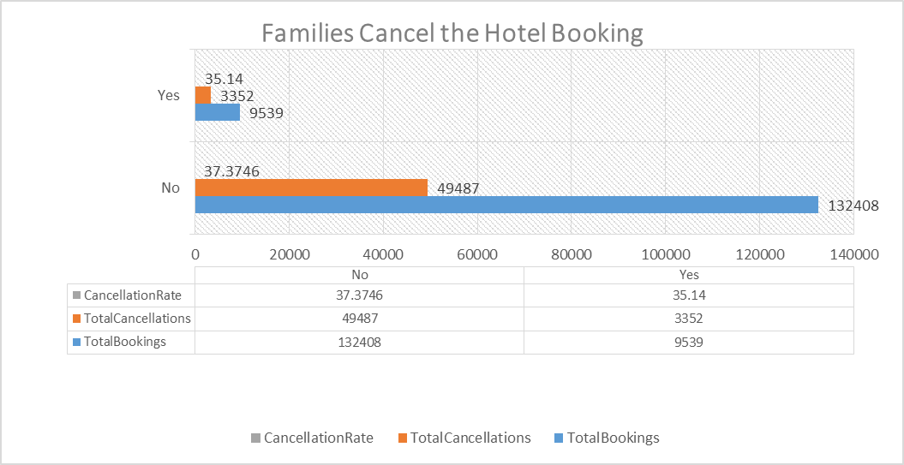
Q-5.Are families with kids more likely to cancel the hotel booking?

Slide 9


Thank You

